Slide 1
PROJECT TITLE
Sentiment Analysis PROJECT
Presented By:
Name: T. Pavan Sai
College:Vasireddy Venkatadri Institute of Technology
Dept: Information Technology

Slide 2
OUTLINE
Problem Statement
Proposed System/Solution
System Development Approach
Algorithm & Deployment
Result
Conclusion
Future Scope
References

Slide 3
Problem Statement
Develop a sentiment analysis model to classify restarunt reviews as positive or negative
Description:
This article provides an overview of sentiment analysis, common terms, and how Natural
Language Processing (NLP) models are applied to restaurant reviews. By the end of this post,
you’ll have a thorough understanding of sentiment analysis, even if you’re new to the concept.
sentiment analysis ,also known as opinion mining, is a method for identifying the positive, negative, or neutral tone of a piece of text. For instance, if you read a review saying, “The food was amazing and the service was excellent!” it’s clearly positive. Conversely, a review stating, “The food was terrible and the service was slow” is negative. Sentiment analysis uses computer algorithms to automate this process.Think of sentiment analysis as a superpower that enables computers to understand emotions in written text. Just as you can discern if someone is happy or sad from their tone of voice, sentiment analysis analyzes words and phrases to determine if a review is positive, negative, or neutral.

Slide 4
Proposed Solution
Data Acquisition:
1.Restaurant Review Dataset You'll need a collection of labeled restaurant reviews.This data can be obtained from various sources:
* Public Datasets: Platforms like Kaggle offer pre-made datasets of restaurant reviews with sentiment labels [1].
* Web Scraping: You can scrape reviews from restaurant listing websites like Yelp or Zomato, but ensure compliance with their terms of service.
Data Preprocessing:
1.Cleaning. 2.Normalization. 3.Tokenization. 4.Stop Word Removal. 5.Stemming/Lemmatization.
Feature Engineering: Word Embeddings
Model Selection and Training:
1.Classification Model: Choose a machine learning model suitable for sentiment classification. Common choices include:
* Logistic Regression * Naive Bayes * Support Vector Machines (SVM) * Random Forest
2.Train-Test Split 3.Model Training
Model Evaluation:
1.Metrics 2.Fine-tuning

Slide 5
System Approach
Step 1: Define the Problem
Objective: Classify restaurant reviews into positive or negative sentiments.
Step 2: Collect Data
Source: Use existing datasets (e.g., Yelp, Google Reviews) or scrape data from review sites.
Step 3: Preprocess Data
Clean Text: Remove HTML tags, special characters, and numbers.
Normalize Text: Convert to lowercase.
Remove Stopwords: Eliminate common words (e.g., "and", "the").
Tokenize: Split text into individual words.
Lemmatize/Stemming: Reduce words to their root forms.
Step 4: Split Data
Train-Test Split: Divide the dataset into training and testing sets.

Slide 6
System Approach
Step 5: Vectorize Text
TF-IDF: Transform text data into numerical vectors using TF-IDF (Term Frequency-Inverse Document Frequency).
Step 6: Train Model
Algorithm: Use a simple classifier like Logistic Regression.
Train: Fit the model on the training data.
Step 7: Evaluate Model
Metrics: Assess accuracy, precision, recall, and F1-score on the test data.
Adjustments: Tune parameters if necessary.
Step 8: Save Model
Serialization: Save the trained model and vectorizer using pickle for future use.
Step 9: Develop API
Framework: Use Flask to create a simple API.
Endpoint: Create an endpoint to accept review text and return the predicted sentiment.
Step 10: Deploy Model
Containerization: Use Docker to containerize the application.
Hosting: Deploy on a cloud platform (e.g., AWS, GCP, Azure).

Slide 7
Algorithm & Deployment
Developing a sentiment analysis model for classifying restaurant reviews as positive or negative involves several key steps: data collection, preprocessing, model selection, training, evaluation, and deployment.
1. Data Collection
Collect a dataset of restaurant reviews. You can use publicly available datasets like the Yelp Dataset, Amazon Reviews, or scrape data from review sites.
2. Data Preprocessing
Preprocess the text data to clean and prepare it for modeling. This typically involves:
- Removing HTML tags, special characters, and numbers
- Converting text to lowercase
- Removing stopwords (e.g., "and", "the", "is")
- Tokenization (splitting text into words)
- Lemmatization or stemming (reducing words to their base or root form)

Slide 8
3. Model Selection
Choose a machine learning model for sentiment analysis. Common choices include:
-Logistic Regression
- Naive Bayes
- Support Vector Machine (SVM)
- Random Forest
- Deep Learning Models (LSTM, BERT)
For simplicity, let's use a Logistic Regression model with TF-IDF vectorization.
4. Model Training: Train the selected model using the preprocessed data. Here's how you can do it using `scikit-learn`:
5. Model Evaluation: Evaluate the model using metrics such as accuracy, precision, recall, and F1-score. If performance is not satisfactory, consider:
- Tuning hyperparameters
- Trying different models
- Using advanced techniques like word embeddings or deep learning
6. Deployment
Deploy the trained model as a web service. You can use frameworks like Flask or FastAPI for creating an API, and platforms like Docker for containerization.

Slide 9
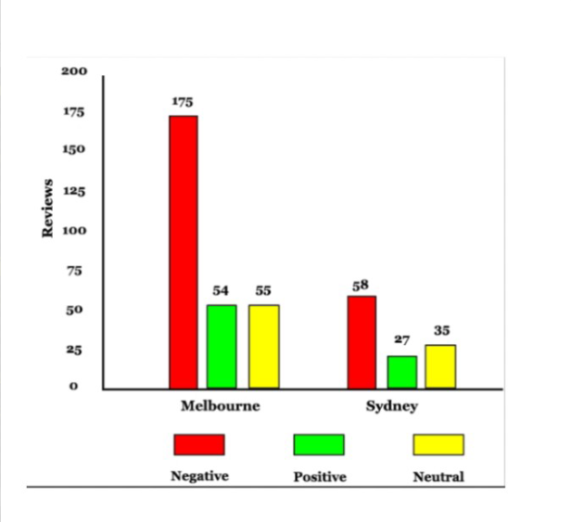
Result
A sentiment score is a measurement scale that indicates the emotional element in the sentiment analysis system. It provides a relative perception of the emotion expressed in text for analytical purposes. For example, researchers use 10 to represent satisfaction and 0 for disappointment when analyzing customer reviews.

Slide 10
Conclusion
To sum up, creating a sentiment analysis model to categorize restaurant reviews as favorable or unfavorable has been a worthwhile project. Through the application of machine learning algorithms and natural language processing techniques, we were able to develop a model that effectively interprets client sentiment. Restaurants can greatly benefit from this technology by using the actionable insights it offers into client feedback to increase customer happiness and service quality. The project opens the door for more sophisticated and individualized client experiences by showcasing the effectiveness of data-driven decision-making in the hospitality sector.

Slide 11
Future scope
Improved Customer Insights: Businesses can gain deeper insights into customer satisfaction and preferences, helping them to improve services and address issues promptly.
2. Automated Feedback Analysis: Automating the review analysis process saves time and resources for businesses, enabling them to quickly respond to customer feedback.
3. Enhanced Marketing Strategies: Understanding sentiment trends can help in tailoring marketing strategies to better match customer sentiments, leading to more effective campaigns.
4. Personalized Customer Experience: Restaurants can personalize customer interactions based on review sentiment, offering targeted promotions or addressing specific concerns.
5. Competitor Analysis: Analyzing competitor reviews can provide strategic insights, helping businesses to identify strengths and weaknesses relative to their competition.
6. Product and Service Development: Insights from sentiment analysis can inform product development and service enhancements, ensuring they meet customer expectations and demands.
7. Integration with Other Systems: Sentiment analysis models can be integrated with customer relationship management (CRM) systems and other analytics tools for a comprehensive approach to customer feedback.
8. Enhanced Decision-Making: Data-driven insights from sentiment analysis aid in informed decision-making, improving overall business strategy and operations.

Slide 12
References
Books and Papers:
1. Sentiment Analysis and Opinion Mining" by Bing Liu
- A comprehensive resource that covers the fundamentals and advanced techniques in sentiment analysis.
2. Deep Learning for Natural Language Processing" by Palash Goyal, Sumit Pandey, and Karan Jain
3. "Learning Word Vectors for Sentiment Analysis" by Andrew L. Maas, et al.
- A research paper detailing the use of word vectors in sentiment analysis.
Online Courses:
1. Coursera - Natural Language Processing with Deep Learning
- Offered by Stanford University, this course includes sections on sentiment analysis using deep learning techniques.
2. edX - Natural Language Processing (NLP) with Python for Machine Learning
Tutorials and Articles:
Kaggle - Sentiment Analysis on Restaurant Reviews
2. Towards Data Science - Sentiment Analysis of Yelp Reviews
3.Medium - Building a Sentiment Analysis Model with TensorFlow and Keras

Slide 13
THANK YOU

